Slide 1
Data Science Life Cycle
Activities and Sequencing

Slide 2
Introduction
Data Science efforts are typically executed as projects
They are typically research projects, not build-and-operate projects
Projects typically have a start and end state
Projects have phases and activities
Transitions happen between phases/activities
Notes:
Data Science efforts are typically executed as projects
They are not things with a set tone that you can just go and execute and get away from it. There is a lot of thinking involved.

Slide 3
The usual workflow
Ask the right questions
Frame the question so that you can define what needs measuring
Select the appropriate data for measurement and cleaning that up
Find patterns to extract key points

Slide 4
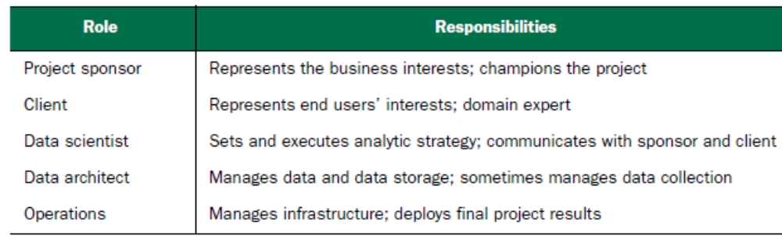
Project roles
Data science project roles and responsibilities
Sometimes these roles may overlap.
Some roles—in particular client, data architect,and operations—are often filled by people who aren’t on the data science project team, but are key collaborators.

Slide 5
Project Sponsor
The sponsor is the person who wants the data science result; generally they represent the business interests.
The sponsor is responsible for deciding whether the project is a success or failure.
The data scientist may fill the sponsor role for their own project if they feel they know and can represent the business needs, but that’s not the optimal arrangement.

Slide 6
Project Sponsor
The ideal sponsor meets the following condition: if they’re satisfied with the project outcome, then the project is by definition a success.
It’s critical to keep the sponsor informed and involved.
  Show them plans, progress, and intermediate successes or failures in terms they can understand.
  A good way to guarantee project failure is to keep the sponsor in the dark.

Slide 7
Project Sponsor
Getting sponsor sign-off becomes the central organizing goal of a data science project.
To ensure sponsor sign-off, you must get clear goals from them through directed interviews.
  You attempt to capture the sponsor’s expressed goals as quantitative statements.
  An example goal might be “Identify 90% of accounts that will go into default at least two months before the first missed payment with a false positive rate of no more than 25%.”

Slide 8
Client
The client is the role that represents the model’s end users’ interests.
Sometimes the sponsor and client roles may be filled by the same person.
The client is more hands-on than the sponsor; they’re the interface between the technical details of building a good model and the day-to-day work process into which the model will be deployed.

Slide 9
Client
They aren’t necessarily mathematically or statistically sophisticated, but are familiar with the relevant business processes and serve as the domain expert on the team.
As with the sponsor, you should keep the client informed and involved.
Ideally you’d like to have regular meetings with them to keep your efforts aligned with the needs of the end users.

Slide 10
Client
Generally the client belongs to a different group in the organization and has other responsibilities beyond your project.
Keep meetings focused, present results and progress in terms they can understand, and take their critiques to heart.
If the end users can’t or won’t use your model, then the project isn’t a success, in the long run.

Slide 11
Data Scientist
The one responsible for taking all necessary steps to make the project succeed, including setting the project strategy and keeping the client informed.
They design the project steps, pick the data sources, and pick the tools to be used.
Since they pick the techniques that will be tried, they have to be well informed about statistics and machine learning.

Slide 12
Data Scientist
They’re also responsible for project planning and tracking, though they may do this with a project management partner.
At a more technical level, the data scientist also looks at the data, performs statistical tests and procedures, applies machine learning models, and evaluates results—the science portion of data science.

Slide 13
Data Architect
The data architect is responsible for all of the data and its storage.
Often this role is filled by someone outside of the data science group, such as a database administrator or architect.
Data architects often manage data warehouses for many different projects, and they may only be available for quick consultation.

Slide 14
Operations
The operations role is critical both in acquiring data and delivering the final results.
The person filling this role usually has operational responsibilities outside of the data science group.
For example, if you’re deploying a data science result that affects how products are sorted on an online shopping site, then the person responsible for running the site will have a lot to say about how such a thing can be deployed.

Slide 15
Operations
This person will likely have constraints on response time, programming language, or data size that you need to respect in deployment.
The person in the operations role may already be supporting your sponsor or your client, so they’re often easy to find (though their time may be already very much in demand).

Slide 16
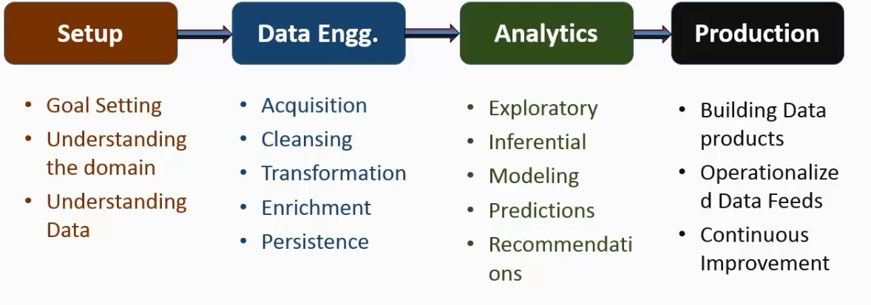
Data Science Project Phases/Activities
Notes:
This is an overview of a data science project phases/activities with 4 broad categories.
In the production stage, we expect to build data products that do everything w/c you just did in an automated and repeatable and keeps producing desired output.

Slide 17
Set-up
Goal Setting
Understanding the Domain
Understanding the Data

Slide 18
Goal Setting
Every Data Science Project will/should have defined a measurable and quantifiable goal.
The team will focus their activities based on this goal.
Projects without goals are cars without a driver
Examples
  Predict which customer(s) will churn in the next month
  Group tweets about the company based on sentiment
  Identify patients with a possibility of having a heart attack in the next 3 months

Slide 19
Goal Setting
A concrete goal begets concrete stopping conditions and concrete acceptance criteria.
The less specific the goal, the likelier that the project will go unbounded, because no result will be “good enough.”
If you don’t know what you want to achieve, you don’t know when to stop trying—or even what to try.
When the project eventually terminates—because either time or resources run out—no one will be happy with the outcome.

Slide 20
Understanding the Problem Domain
At this stage, learn all that you can about the context of your project:
  Why do the sponsors want the project in the first place? What do they lack, and what do they need?
  What are they doing to solve the problem now, and why isn’t that good enough?
  What resources will you need: what kind of data and how much staff? Will you have domain experts to collaborate with, and what are the computational resources?
  How do the project sponsors plan to deploy your results? What are the constraints that have to be met for successful deployment?
Notes:
What is the business all about
Machines do not understand business
For example, cholesterol level

Slide 21
Understanding the Problem Domain
Data science team should have solid understanding of the problem domain
  Business basics (finance, CRM, medical)
  Business processes and workflows
  Key Performance metrics
Machines only know numbers and strings, they need humans to associate meaning to them
It helps validate assumptions, identifies errors and analyze if predictions will work
Notes:
What is the business all about
Machines do not understand business
For example, cholesterol level

Slide 22
Data
Business Processes and workflows generate DATA
  Application Data Entries
  Reports and Visualizations
  Sensor Data feeds
  Web clicks in a browser
  POS transactions
  Social media feeds
Data can be structured, unstructured, semi-structured
Data have different origins, stored in different locations and have logical relationships
Notes:
Multiple sources, multiple systems

Slide 23
Understanding Data
This step encompasses identifying the data you need, exploring it, and conditioning it to be suitable for analysis.
This stage is often the most time-consuming step in the process.
It’s also one of the most important:
  What data is available to me?
  Will it help me solve the problem?
  Is it enough?
  Is the data quality good enough?
Notes:
valid

Slide 24
Understanding Data
Source of the data
Processing/transformation steps done on the data
Storage(enterprise database, cloud...)
Synchronization
Relationships
Ordering
Understanding data helps the team identify possible sources of predictive patterns
Notes:
What data you have is very important. You want to understand the source of the data. How reliable is the data? Is it machine generated or entered by humans? Is there the possibility of someone manipulating data entry and getting away with it? How good your data will determine how good your predictions will be. So data has to be valid
You need to understand what forms of processing and transformations that were performed on the data. Are you losing information because summarized the data
How is the data synchronized across the different sources.
Ordering refers to the order that data was generated.
valid

Slide 25
Setting expectations
Setting expectations is a crucial part of defining the project goals and success criteria.
The business-facing members of your team (in particular, the project sponsor) probably already have an idea of the performance required to meet business goals.
Before you get too deep into a project, you should make sure that the resources you have are enough for you to meet the business goals.

Slide 26

Data Science Project Phases/Activities

Slide 27
Data Engineering
Get the data to the form you need it
Notes:
You’ve already done all the set-up and data engineering is what you do in order to the data from where it is today to the form you want it to be.Data is out there: you want to obtain/get raw, unmanaged

Slide 28
Data Acquisition
Acquire data from different data sources
  Enterprise Databases (Oracle, MySQL)
  Cloud APIs (Sales Force)
  Scanner/sensor feeds
  Social media downloads
Real time/ interval and bulk
Sanity checking
Most cumbersome and time-consuming to setup
Establishing connections to machines and humans involved
Notes:
Sanity checking – making sure you have all the data you need and no is lost in the transport layer
Cumbersome because of security concerns-there are entities owning these databases, there are security/sharing policies involved

Slide 29
Data Cleansing
Data have different degrees on cleanliness and completeness
Structured data from corporate applications are usually clean and complete
Data from internet, social media or voice transcription may need cleansing.
Handling missing data is a key decision
Cleansing examples
  Normalize date formats (dd/mm/yy or mm-dd-yy))
  Standardize decimal places
  First/Last name vs last/first name
Notes:
Data from internet...may not be complete, they come in all kinds of multiple formats, all kinds of abbreviations, neologisms
Missing data – null vs na vs zero

Slide 30
Data Transformation
Data is transformed to extract required information while discarding unnecessary baggage
Processing and summarization to logical activity levels
Transforming helps cut down data size and minimize further processing needs
Examples
  Web clicks summarized by website visit
  Language translations
  Medical sensor data summarized by interval
Notes:
You want your data to be in a certain form/shape.
Unnecessary baggage-data you don’t need or irrelevant to present project.

Slide 31
Data Enrichment
Add additional attributes to data records that improve the quality information
Examples
  Add demographics information from a customer data to the POS transaction record
  Logical grouping of patients by past medical history-excellent health, moderate, needs consistent care

Slide 32
Data Persistence
Processed data is stored in a reliable, retrievable data sink
All relevant information captured in a single local record as much as possible
Example
  Retail store transaction
    POS data + customer characteristics + item characteristics + sales associate performance
Notes:
Capture all relevant record

Slide 33
Data Persistence
Scaling and query performance are important factors in the choice of a data sink
  Flat files
  Traditional SQL databases
  Big Data technologies

Slide 34
Data Science Project Phases/Activities

Slide 35
What is analytics?
“Analytics is the scientific process of transforming data into insight for better decisions. ¹
¹ Informs, “What is Analytics,” www.informs.org/About-INFORMS/What-is-Analytics , 2016

Slide 36
Types of Data Analysis Questions
In approximate order of difficulty
Descriptive
Exploratory
Inferential
Predictive
Causal
Mechanistic
Notes:
Not all data analyses are created equal.
Each data analysis might address a slightly different question, and require slightly different data types, to be able to answer that question. We categorize the types of data analysis questions into these six categories.

Slide 37
Descriptive Analysis
Goal: Describe a set of data
The first kind of data analysis performed
Commonly applied to census data
The description and interpretation are different steps
Descriptions can usually not be generalized without additional statistical modeling

Slide 38
Exploratory Data Analysis
Goal: Find characteristics/relationships you didn't know about
Exploratory models are good for discovering new connections
They are also useful for defining future studies
Exploratory analyses are usually not the final say
Exploratory analyses alone should not be used for generalizing/predicting
Correlation does not imply causation

Slide 39
Exploratory Data Analysis
You get to know the data better during the exploration and cleaning phase; after you have a sense of the data, you can get a sense of whether the data is good enough to meet desired performance thresholds.
If it’s not, then you’ll have to revisit the project design and goal-setting stage.

Slide 40
Inferential Analysis
Goal: Use a sample to say something about a population
Inference is commonly the goal of statistical models
Inference involves estimating both the quantity you care about and your uncertainty about your
estimate
Inference depends heavily on both the population and the sampling scheme

Slide 41
Predictive Analysis
Goal: To use the data on some objects to predict values for another object
If X predicts Y it does not mean that X causes Y
Accurate prediction depends heavily on measuring the right variables
Although there are better and worse prediction models, more data and a simple model works really well
Prediction is very hard, especially about the future references

Slide 42
Modeling
An analytical model is a statistical model that is designed to perform a specific task or to predict the probability of a specific event.
In layperson’s terms, a model is simply a mathematical representation of a business problem.
Machine learning algorithms are often used to build models
  Different algorithms and different datasets are used to build multiple models

Slide 43
Modeling
Identify best performing model
  Accuracy
  Response Time
  Resources
Can be as simple as an equation or a decision tree or as complex as a neural network.

Slide 44
Modeling
The most common data science modeling tasks are these:
Classification
  Deciding if something belongs to one category or another
Scoring
  Predicting or estimating a numeric value, such as a price or probability
Ranking
  Learning to order items by preferences

Slide 45
Modeling
(cont’d)
Clustering
  Grouping items into most-similar groups
Finding relations
  Finding correlations or potential causes of effects seen in the data
Characterization
  Very general plotting and report generation from data

Slide 46
Prediction
Use models built to predict outcomes for new data
Keep validating model accuracy to make sure accuracy levels are consistent for different variations in data
Response time and resource usage are critical when predictions need to happen in real time
Simulations might be performed to validate prediction benefits

Slide 47
Causal analysis
Goal: To find out what happens to one variable when you make another variable change.
Usually randomized studies are required to identify causation
There are approaches to inferring causation in non-randomized studies, but they are complicated and sensitive to assumptions
Causal relationships are usually identified as average effects, but may not apply to every individual
Causal models are usually the "gold standard" for data analysis

Slide 48
Mechanistic analysis
Goal: Understand the exact changes in variables that lead to changes in other variables for individual objects.
Incredibly hard to infer, except in simple situations
Usually modeled by a deterministic set of equations (physical/engineering science)
Generally the random component of the data is measurement error
If the equations are known but the parameters are not, they may be inferred with data analysis

Slide 49
Model evaluation and critique
Once you have a model, you need to determine if it meets your goals:
Is it accurate enough for your needs? Does it generalize well?
Does it perform better than “the obvious guess”? Better than whatever estimate you currently use?
Do the results of the model (coefficients, clusters, rules) make sense in the context of the problem domain?

Slide 50
Model evaluation and critique
If the answer is “no” to any of the questions, loop back to the modeling step—or decide that the data does not support the goal you’re trying to achieve.
This might mean defining more realistic goals or gathering the additional data or other resources that you need to achieve the original goals.
Notes:
No one likes negative results, but understanding when you can’t meet your success criteria
with current resources will save you fruitless effort. Your energy will be better spent
on crafting success.

Slide 51
Presentation and documentation
Once you have a model that meets your success criteria, you’ll present your results to your project sponsor and other stakeholders.
  Different audiences require different kinds of information., e.g., business-oriented audiences want to understand the impact of your findings in terms of business metrics.
You must also document the model for those in the organization who are responsible for using, running, and maintaining the model once it has been deployed.

Slide 52
Presentation and documentation
A presentation for the model’s end users would emphasize how the model will help them do their job better:
  How should they interpret the model?
  What does the model output look like?
  If the model provides a trace of which rules in the decision tree executed, how do they read that?
  If the model provides a confidence score in addition to a classification, how should they use the confidence score?
  When might they potentially overrule the model?
Presentations or documentation for operations staff should emphasize the impact of your model on the resources that they’re responsible for.

Slide 53
Presentation and documentation
Presentations or documentation for operations staff should emphasize the impact of your model on the resources that they’re responsible for.

Slide 54
Recommendations
At the end of the project, recommendations need to be provided to project owners on the algorithms to use and expected benefits
A data science project might have no recommendations to make if the dataset does not exhibit any exploitable patterns
  Does not mean it is a failure
Sometimes unexpected patterns are discovered that might lead to other benefits
A final presentation is made to stakeholders

Slide 55
Data Science Project Phases/Activities
Notes:
In the production stage, we expect to build data products that do everything w/c you just did in an automated and repeatable and keeps producing desired output.

Slide 56
Production
Implement continuous processes
Notes:
Utilizes all the work you’ve done in the previous phases and do something on a continuous basis

Slide 57
Building Data Products
Once the modeling and prediction are “firmed up”, data products are built that would use the algorithms for production level modeling and predictions
Have quality software rigor in development and testing
Deployed in enterprise or cloud mode
Notes:
You must have a product that is as error-free as possible and is automatic

Slide 58
Operationalized Data Feeds
Continuous data feeds into data products
  Instantaneous
  Consistent
  Periodic
Data products perform cleansing, transformation and error reporting
Pruning of old data might be necessary
Notes:
Pruning: product development up to deployment would have entailed a lot of data gathering some of which may no longer be necessary (eg. Raw data)

Slide 59
Continuous Improvement
Changes in business environment might affect learning and prediction
Learning and prediction steps need to be re-validated at appropriate intervals to make sure they continue to work as desired
Revalidation needs to happen when business processes change
Efforts to generate better models should be ongoing.
Notes:
These must always be taken into consideration because we want our product to be adaptable to situations which we generally consider as being dynamic.

Slide 60
Missing Data
Next Topic

